Slide 1

Biology for Engineers
Unit 1 : Biomolecules and Their Applications
CARBOHYDRATES

Slide 2

Biology for Engineers
Carbohydrates
General Introduction about Carbohydrates
Types
Cellulose
Cellulose based water filters
Methods

Slide 3
Biology for Engineers
Carbohydrates
CARBOHYDRATES ARE BIOLOGICAL MACROMOLECULES LIKE PROTEINS, LIPIDS, VITAMNS, etc.
CARBOHYDRATES – CONSISTS OF CARBON, HYDROGEN AND OXYGEN ATOMS
EMPIRICAL FORMULA – C_{m}(H₂O)_{n}
Example: Glucose, Sucrose, Starch, Cellulose

Slide 4
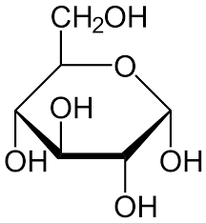
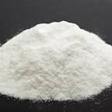
Carbohydrates
Biology for Engineers
Carbohydrates are classified based on their chemical compounds
Monosaccharides - Glucose, Fructose
Disaccharides – Sucrose, Lactose
Oligosaccharides – Maltodextrin, Raffinose
Polysaccharides - Starch, Cellulose, Chitin,
Examples
Glucose

Slide 5
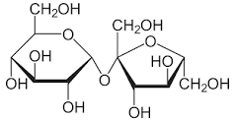
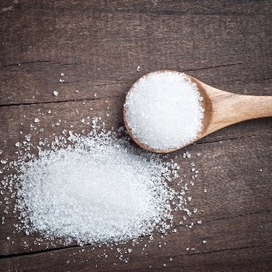
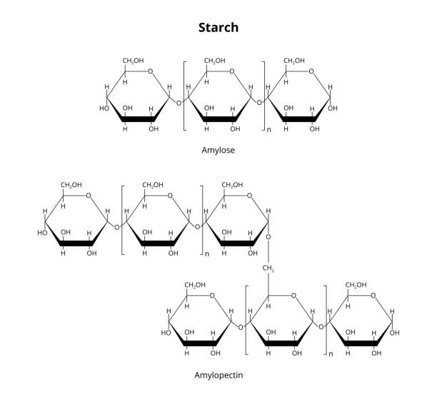
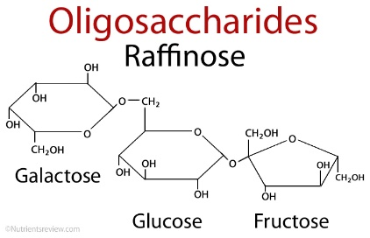
Carbohydrates
Biology for Engineers
Sucrose
Oligosaccharide
Polysaccharide

Slide 6
Carbohydrates
Biology for Engineers
CELLULOSE BASED WATER FILTERS
Cellulose is a Polysaccharide
Cellulose is used for several important industries such as paper making, Cellophane, textiles as well as additives for food and pharmaceuticals and fuel sources cellulosic ethanol.
The global market indicates that the cellulose market’s size was estimated to be USD 211.68 billion in 2019 with an expected increase of compound annual growth rate (CAGR) by 2.9% from 2020 to 2026.
Used for water remediation

Slide 7
Carbohydrates
Biology for Engineers
Used for water remediation
Advantageous because they are natural biopolymers, highly biocompatible, having several functional groups.
Cellulose are prepared in several ways – such as cellulose nano crystals, cellulose nanofibrils, derivatives of Oxidized Cellulose Nanofibrils.
Presence of functional groups such as carboxylic and hydroxyl groups covalently bind to organic moieties helps in specific applications.
Cellulose biopolymers with nanoparticles such as Ag nano particles, graphene oxide, zinc oxide nanoparticles can be used for remediation of water.
These removes water contaminants such as – heavy metal ions, organic dyes, drugs and micro-organisms.
Cellulose can be functionalized by amination, xanthation, sulfonation, thiols, and phosphorylation in adsorption techniques.

Slide 8
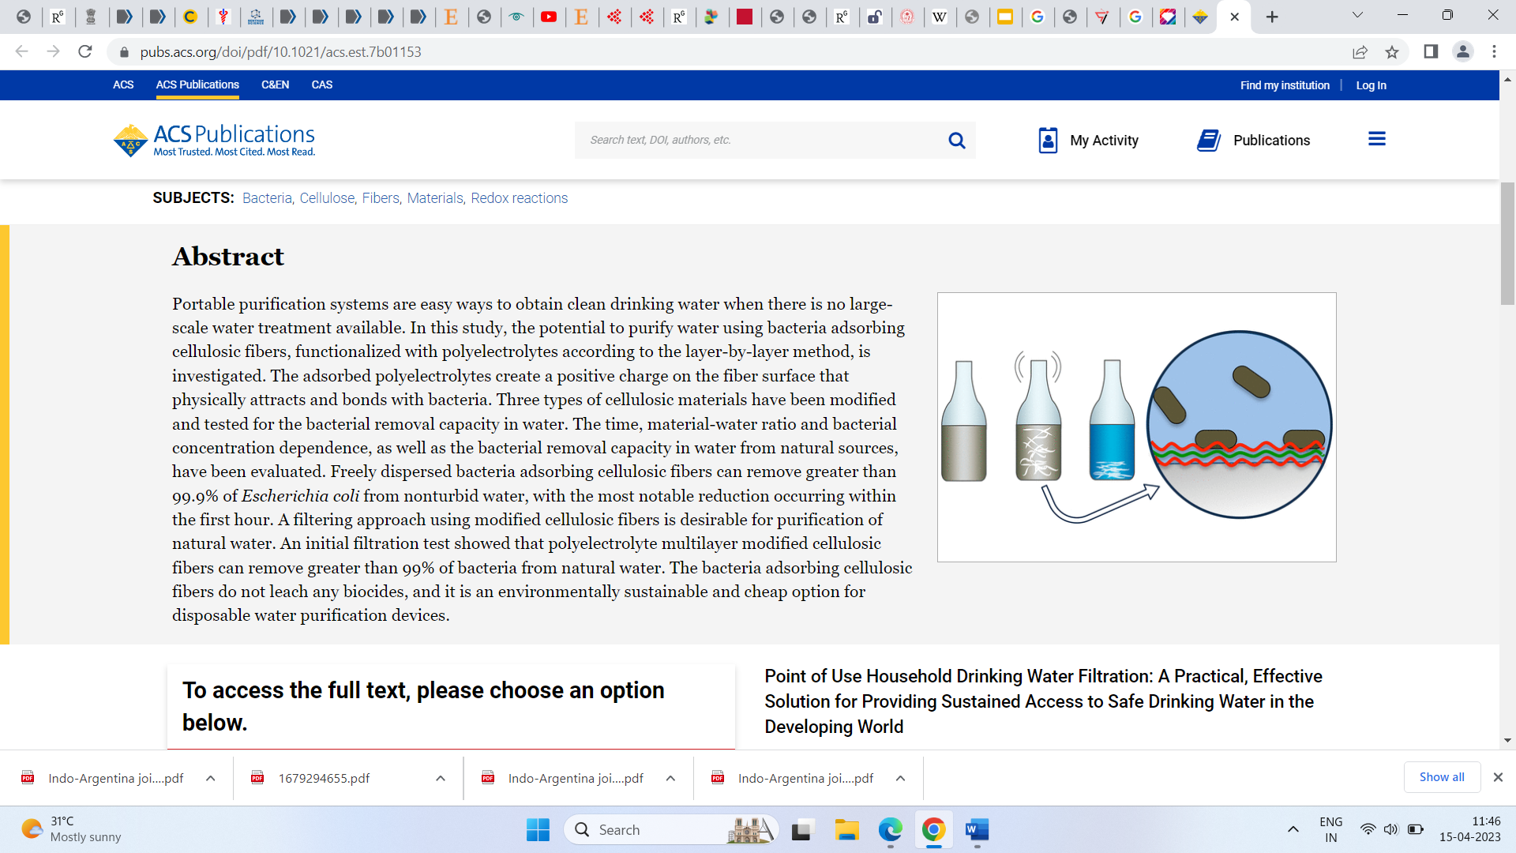
Biology for Engineers
Carbohydrates
CELLULOSE BASED WATER FILTERS

Slide 9
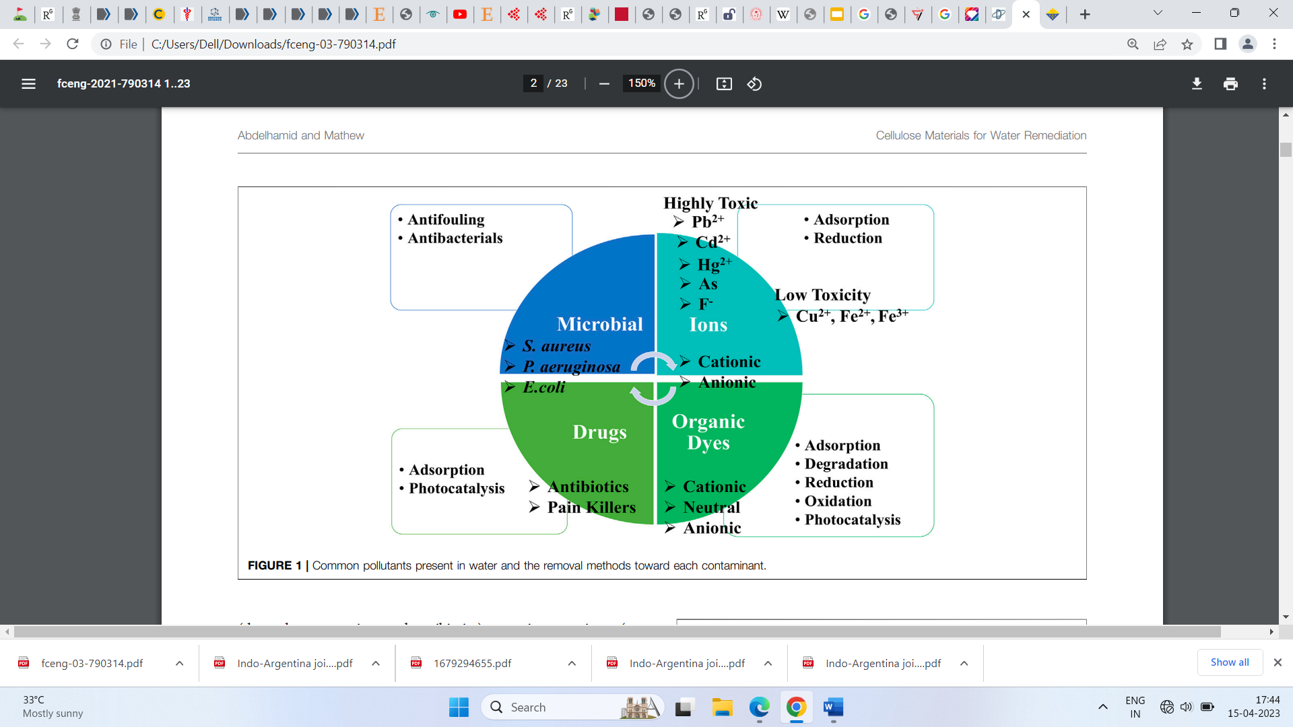
Biology for Engineers
Carbohydrates
Water contaminants and removal methods

Slide 10
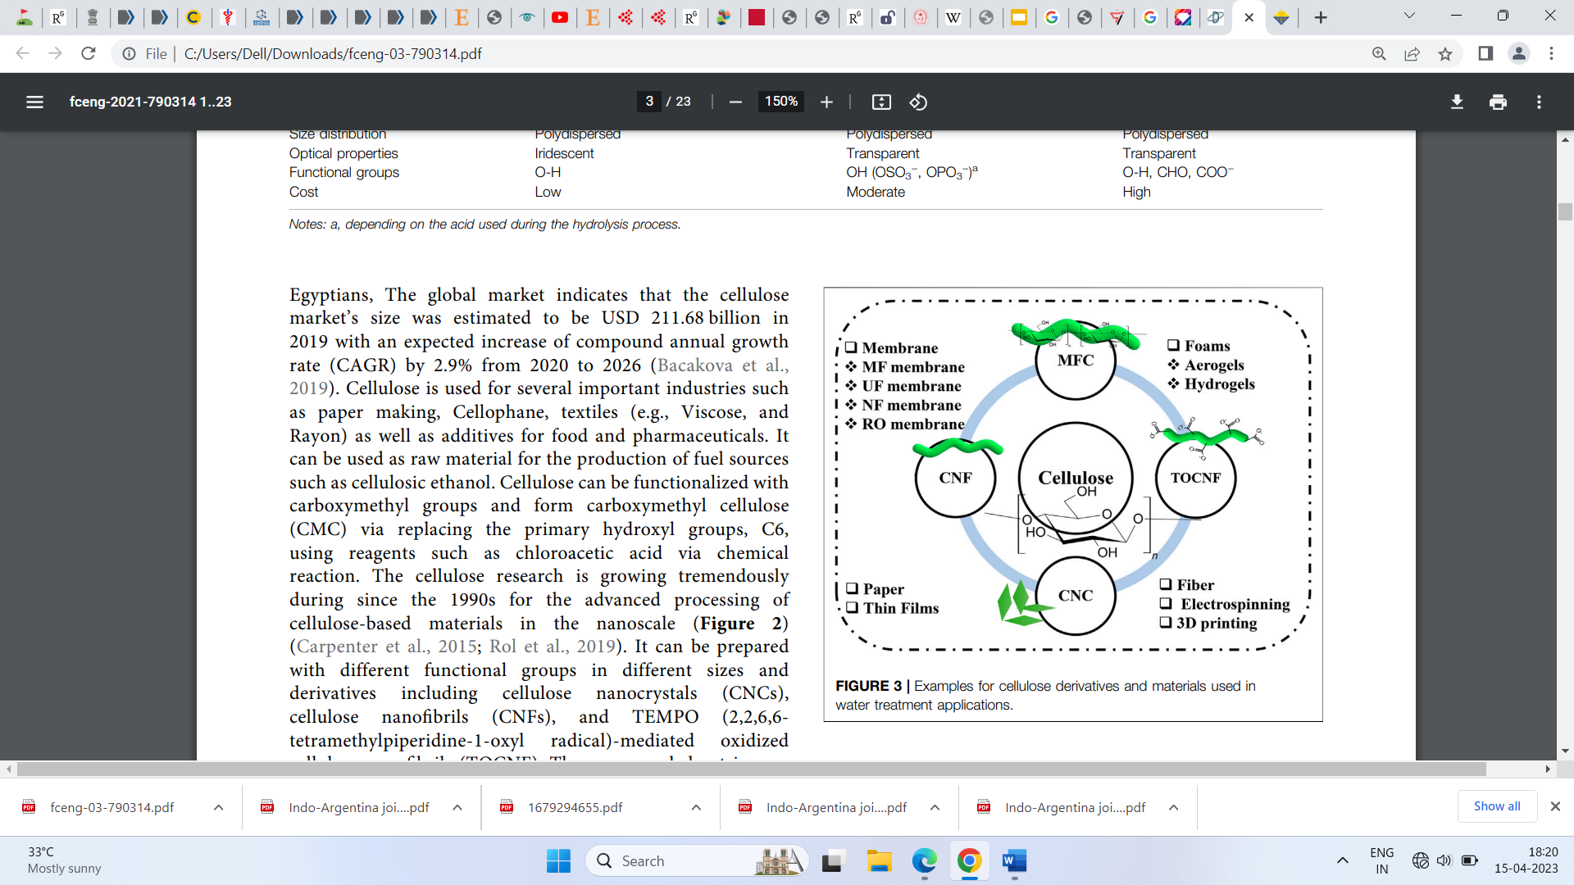
Biology for Engineers
Carbohydrates
Cellulose derivatives used in water treatment

Slide 11
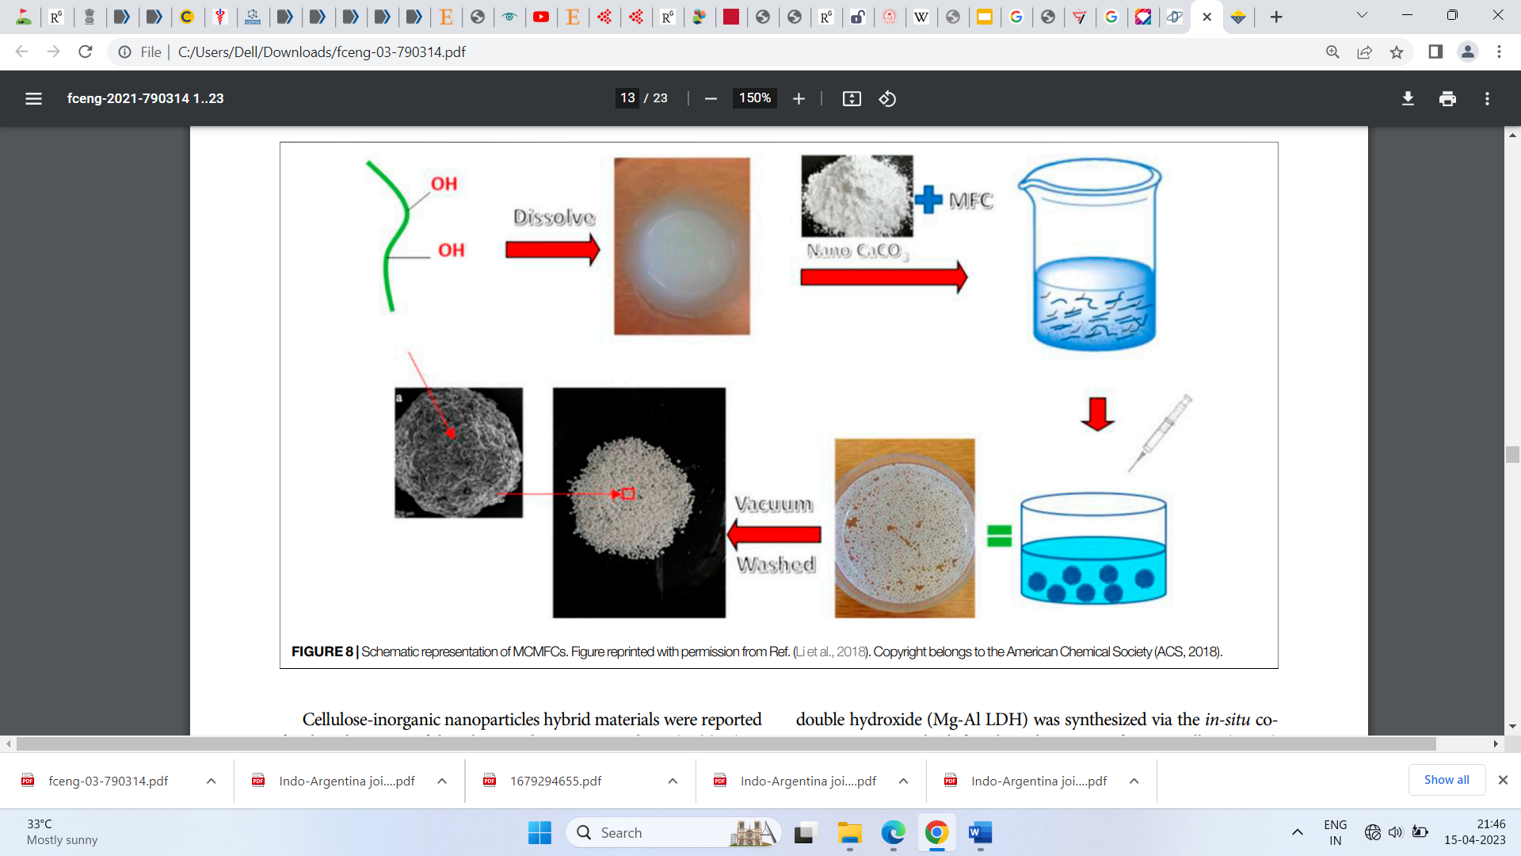
Biology for Engineers
Carbohydrates
Removal of Methylene blue using Cellulose modified with polymers such as polypiperazine, and hydrolyzed polyacrylamide.

Slide 12
Biology for Engineers
Bio-plastic
Bioplastic - PLA (Poly lactic acid) and PHA (Poly hydroxy alkanoates)
Bioplastics differ from conventional plastics
Bioplastics are made of chemicals which are biodegradable or compostable.
Bioplastics consists of Poly lactic acid
Biobased materials consists of starch, sugar, cellulose, lactic acid, proteins used to manufacture bioplastics.
Isolated from Corn, beet sugar, sugar cane, tapioca root etc.
Bioplastics are similar to conventional plastics and offer additional benefits includes reduced carbon footprint, waste management, composting.

Slide 13
Biology for Engineers
Bio-plastics
Three types of Bio Plastics:
Bio-based or partially biobased, non- biodegradable plastics - PE, PP, or PET, PTT
Plastics that are both bio-based and biodegradable – PLA, PHA
Plastics that are based on fossil resources and are biodegradable – PBAT
PLA Bioplastics are more commonly manufactured and widespread
PLA bioplastic is most promising bioplastic, similar to fossil fuel based bioplastic such as PE, PP, PET

Slide 14
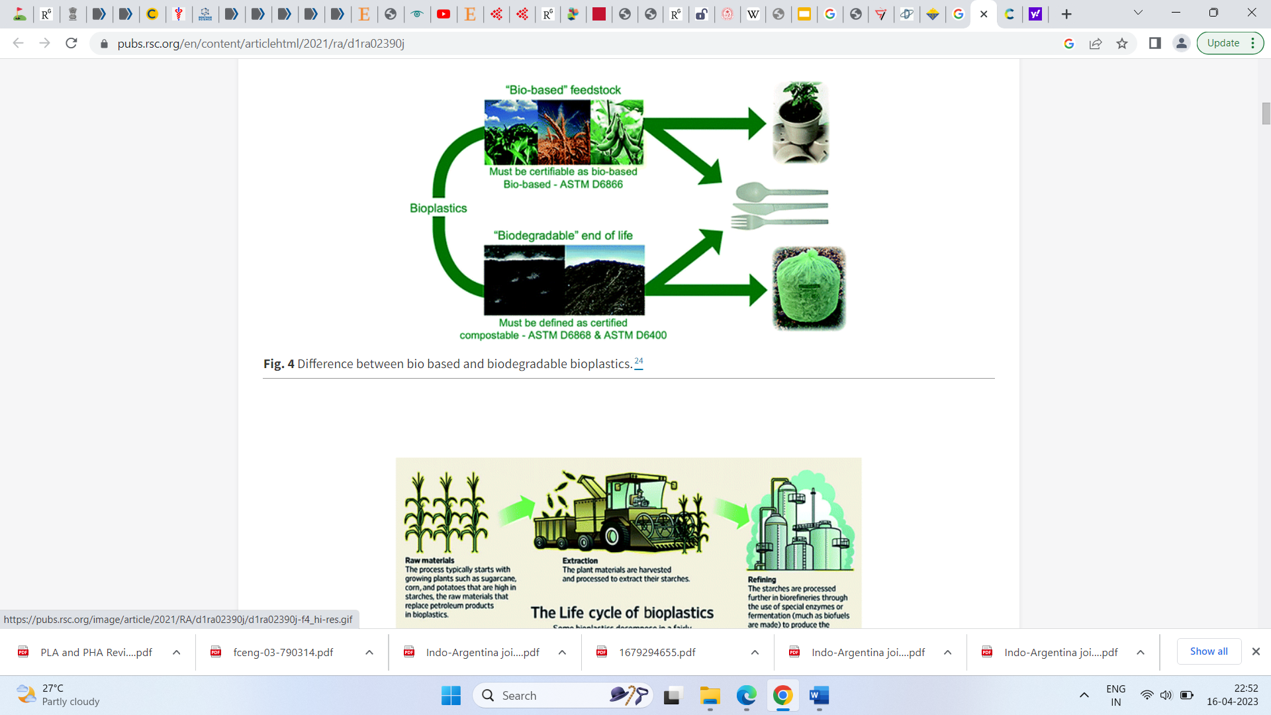
Biology for Engineers
Bio-Plastics
Biobased and Biodegradable bioplastics

Slide 15
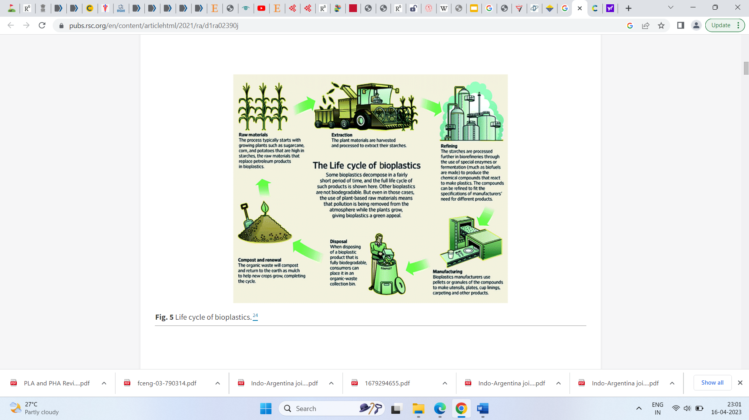
Biology for Engineers
Bio-Plastics
Life cycle of Bioplastics

Slide 16
Biology for Engineers
Bio-Plastics
POLY LACTIC ACID (PLA)
Polylactic acid (PLA) is a biodegradable as well as recyclable polyester made from renewable feedstock.
Lactic acid as the raw material is produced by fermentation of glucose or sucrose and is refined to a high purity.
Mostly produced by the fermentation of starch from crops – wheat, corn,
sugar cane, into lactic acid subsequent polymerization.
PLA is a bioabsorbable material and is widely used in orthopedic surgery
Fixed devices such as dissolvable suture nets and absorbable steel plates are good examples of its medical applications.

Slide 17
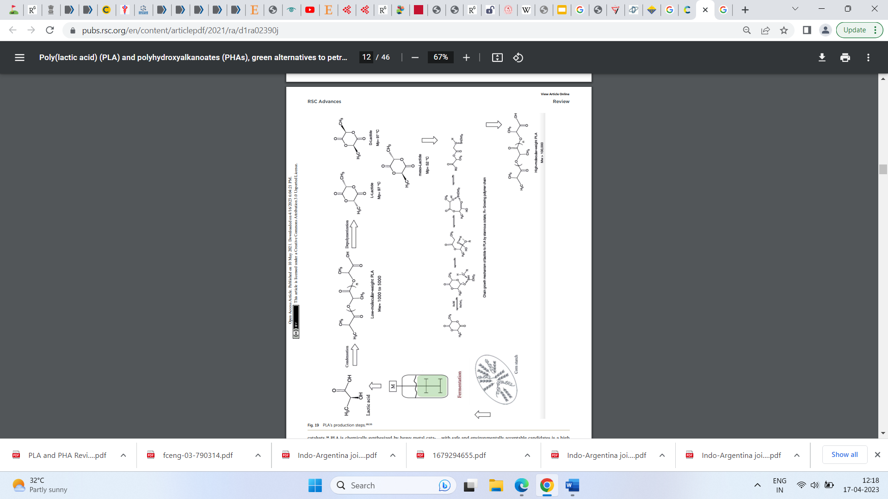
Biology for Engineers
Bio-Plastics
Figure: Steps in Production of PLA

Slide 18
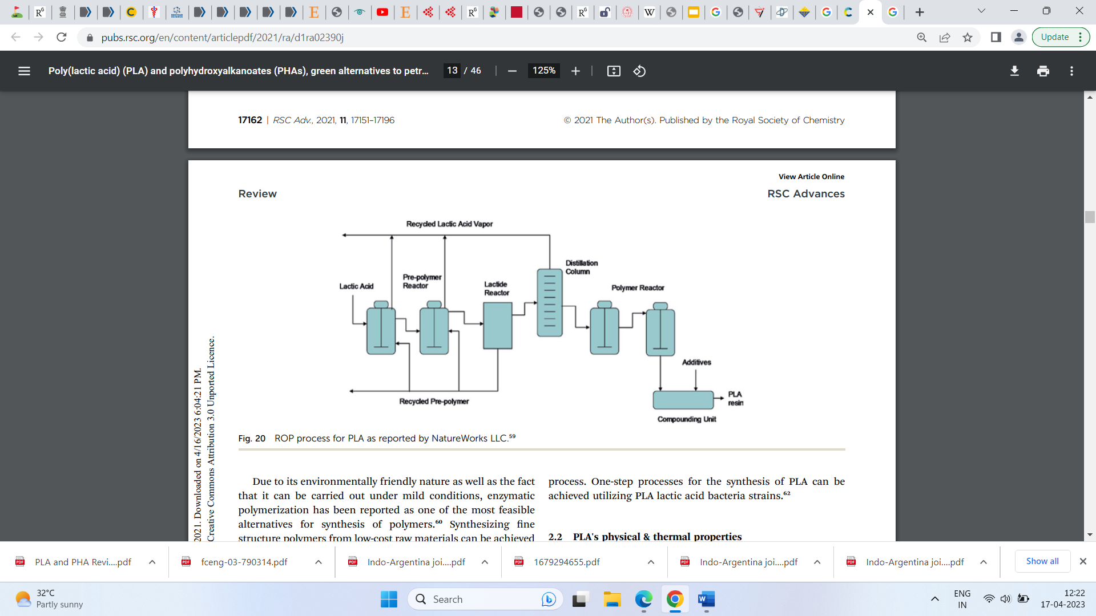
Biology for Engineers
Bio-plastics

Slide 19
Biology for Engineers
Bio-plastics
After PLA production its properties such as Physical and thermal properties, mechanical properties, permeability, degradation, recyclability, sustainability and environmental impact has to be studied.
PLA polymers plastics are also used in medical and pharmaceutical purposes.
PLA plastics are highly stable and transparent.
Disadvantage of PLA plastic is, it softens at 60℃ not suitable for packages of hot drinks and foods. Therefore, it has to be copolymerize with heat resistant polymers.

Slide 20
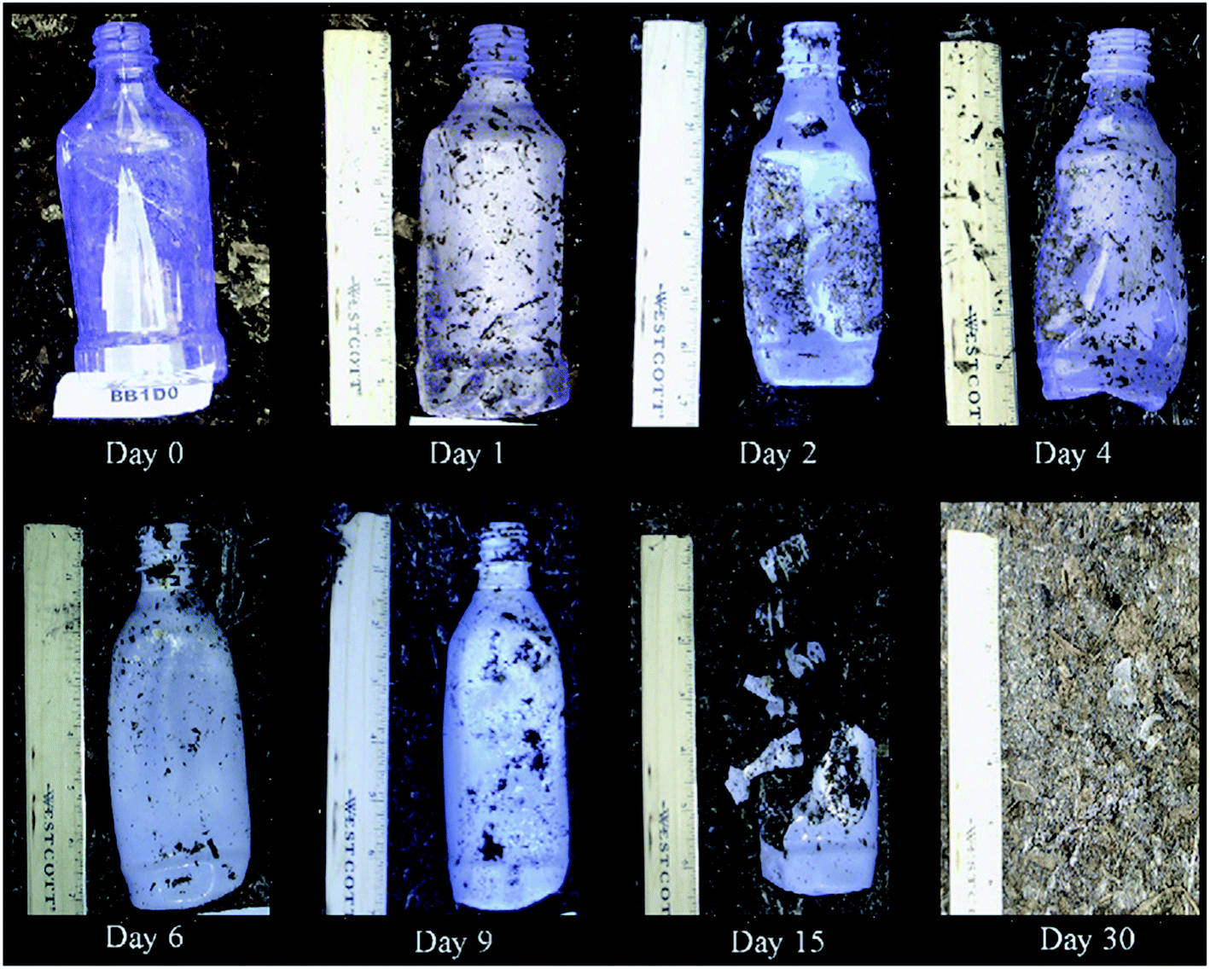
Biology for Engineers
Bio-plastics
Manufacturer: Evonik, Nature works, Danimer Scientific, etc.

Slide 21
Biology for Engineers
Bio-plastics
POLYHYDROXYALKANOATE (PHA)
Biodegradable, biocompatable plastics
commercial PHA are poly-hydroxybutyrate(PHB), polyhydroxybutarate co- valerate (PHBV)
Good mechanical properties like crystalanity, PHB is brittle and restricted its usage.. PHBV is soft and commercially viable
Microorganisms like bacteria is used to produce PHA using fermentation process
Bacterial fermentation using various feedstock – corn. Sugar, vegetable oils resulting in PHA
It can withstand temperature up to 180℃

Slide 22
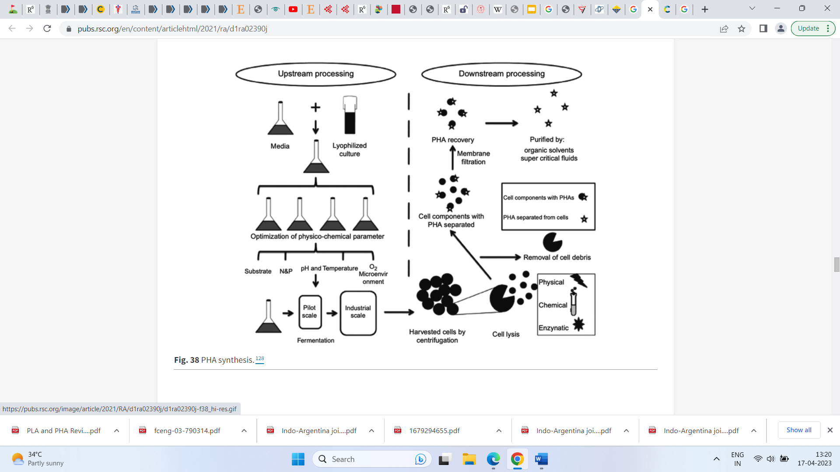
Biology for Engineers
Bio-plastics
PHA MANUFACTURE

Slide 23
Biology for Engineers
Bio-plastics
After PHA production its properties such as Physical and thermal properties, mechanical properties, permeability, degradation, recyclability, sustainability and environmental impact has to be studied.
PHA Manufacturer: Bioon, Metabolix, BioMatera, etc
Therefore, bio-based polymers are moving towards becoming the favourable option to be utilized in polymer manufacturing, food packaging, and medical applications.
Applications :
Medical Field : Biodegradable implants ,drug carrier, biocontrol agents, tissue engineering etc.
Promoted as biodegradable plastics

